Slide 1

Diana F Camacho
Pricing Analyst II
Waste Management

Slide 2


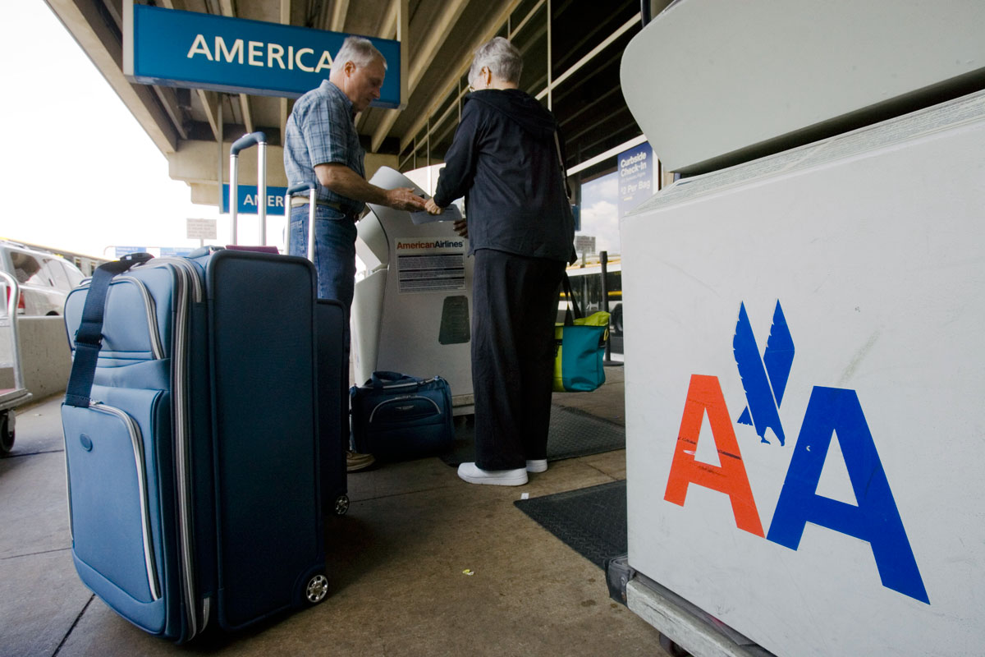

Final Project Mishandled Bag Ratio
US – Airlines Industry
Time Series Analysis

Slide 3

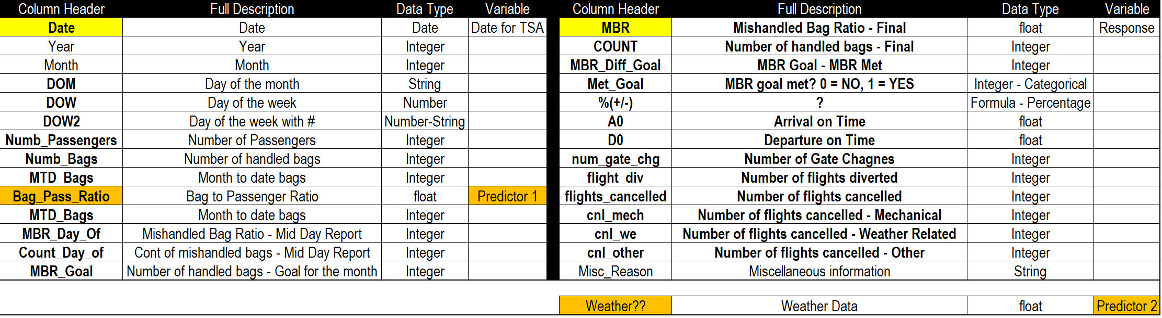
Mishandled Bags Dataset
The dataset describes the daily report used for an airline in an international airport in the US.
Airline name will be PMT & Airport Name HUB1
Data is from 1/1/2016 to 11/30/2017
700 total observations - 27 Columns/Features
”Mishandled Bag Ratio” or MBR - It’s a mishandled bag per every thousand customers
DATA DICTIONARY

Slide 4
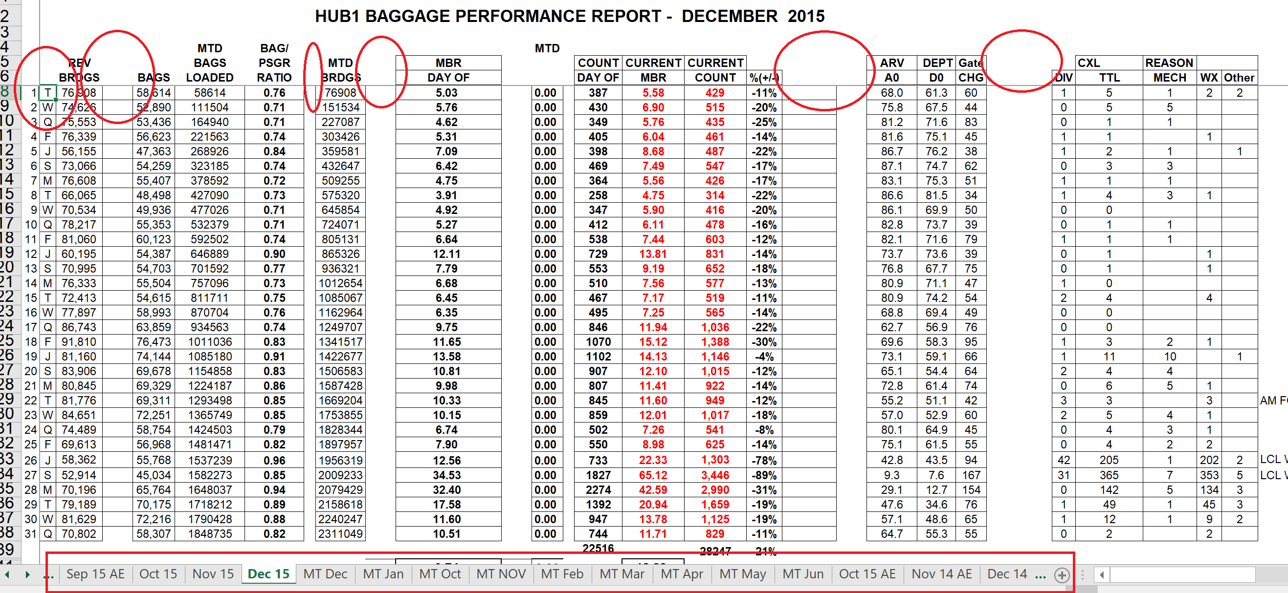
Original MBR Data – HUB1

Slide 5
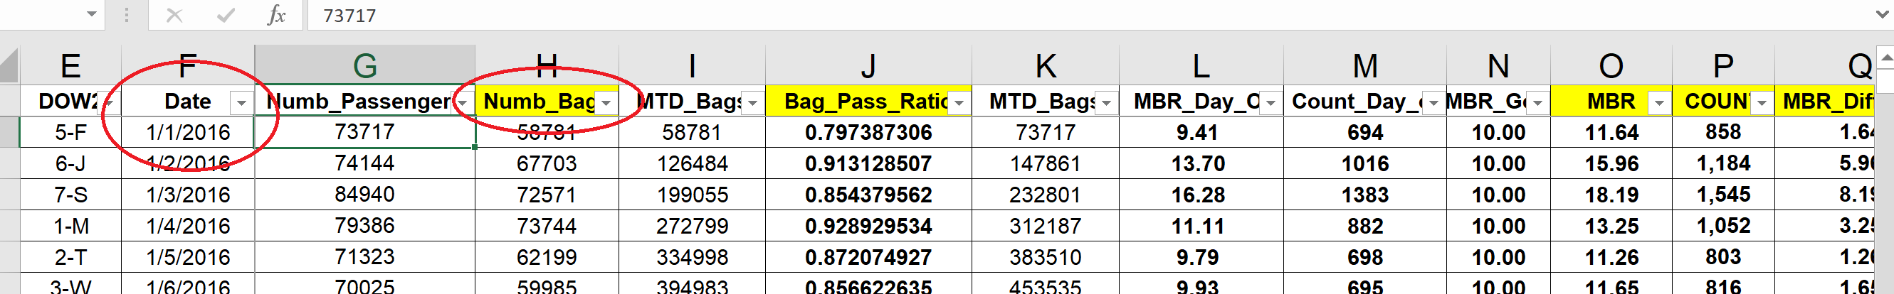
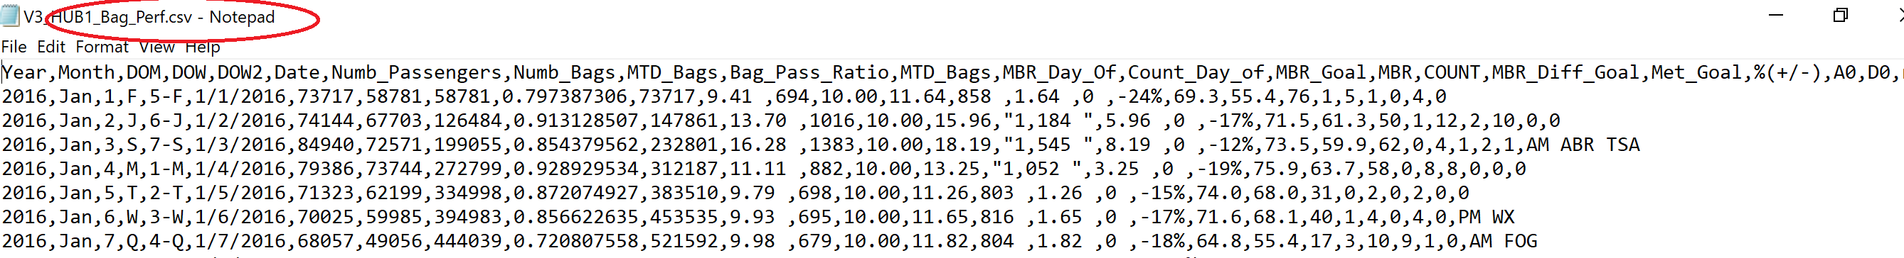
From Excel converted to CSV

Slide 6
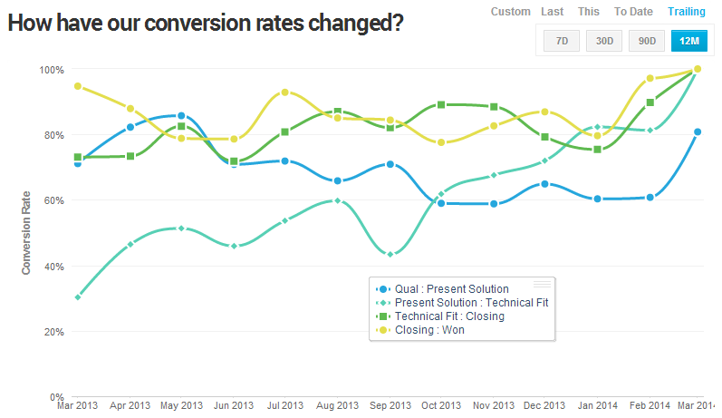
What is Time Series?
Examples Include:
As the name suggests, TS is a collection of data points collected at constant time intervals. These are analyzed to determine the long term trend so as to forecast the future or perform some other form of analysis. But what makes a TS different from say a regular regression problem? There are 2 things:
It is time dependent. So the basic assumption of a linear regression model that the observations are independent doesn’t hold in this case.
Along with an increasing or decreasing trend, most TS have some form of seasonality trends, i.e. variations specific to a particular time frame. For example, if you see the sales of a woolen jacket over time, you will invariably find higher sales in winter seasons. 1
Stock Prices - Daily
Consumer Price Index - Monthly
Sales – Daily, Weekly, Monthly or Annual
Inventory – Monthly
Customers – Daily
Weekly measure of money AR – Monthly
Unemployment…

Slide 7

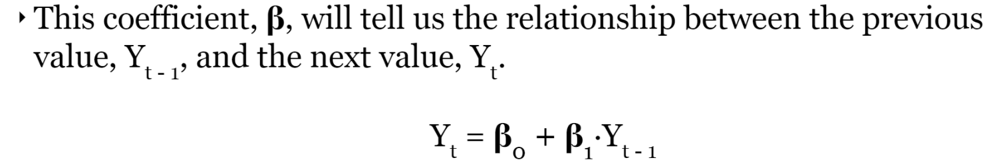
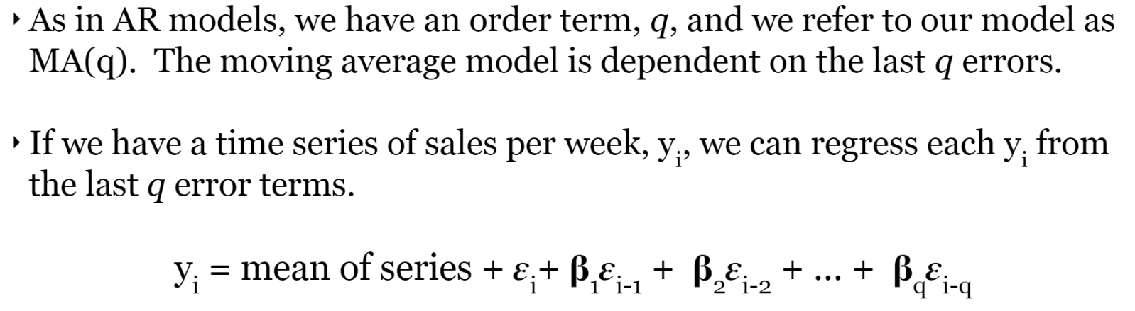
Forecasting Methodologies
There are many different time series techniques.
The technique used will be based on the type
of data and industry is in.
Examples include:
AR – Autoregressive
MA – Moving Average

Slide 8
Forecasting Methodologies
I – Integrated
S – Seasonal Element
X – Introduce Exogenous or Explanatory Variable
The methods can be combined with each other, such as
ARMA, ARIMA, ARIMAX, SARIMAX

Slide 9
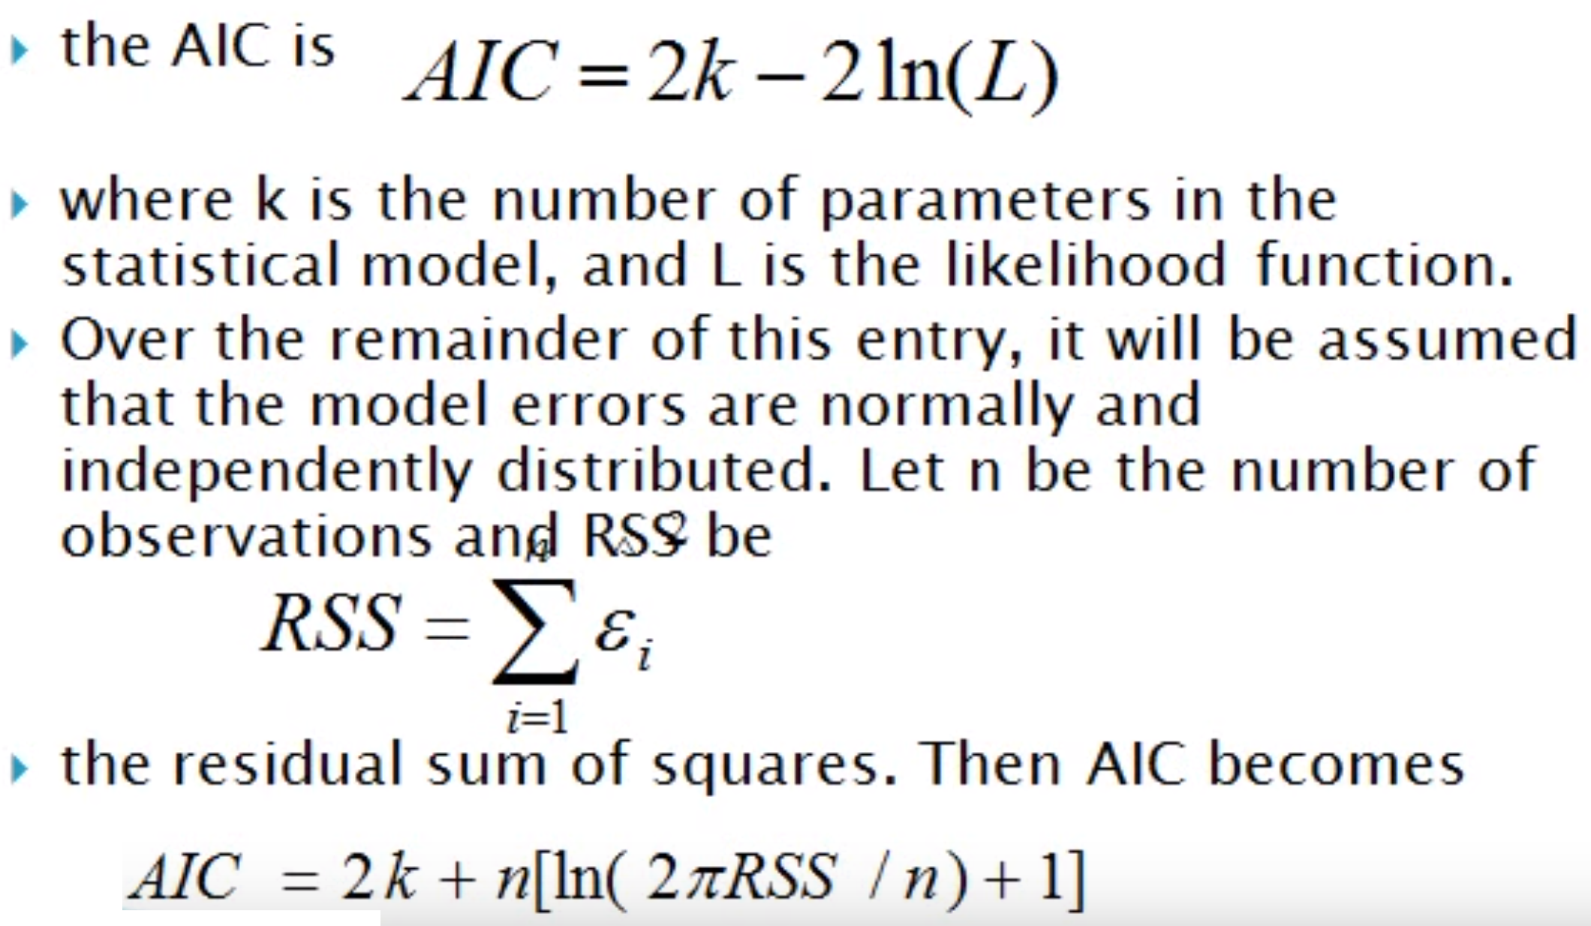
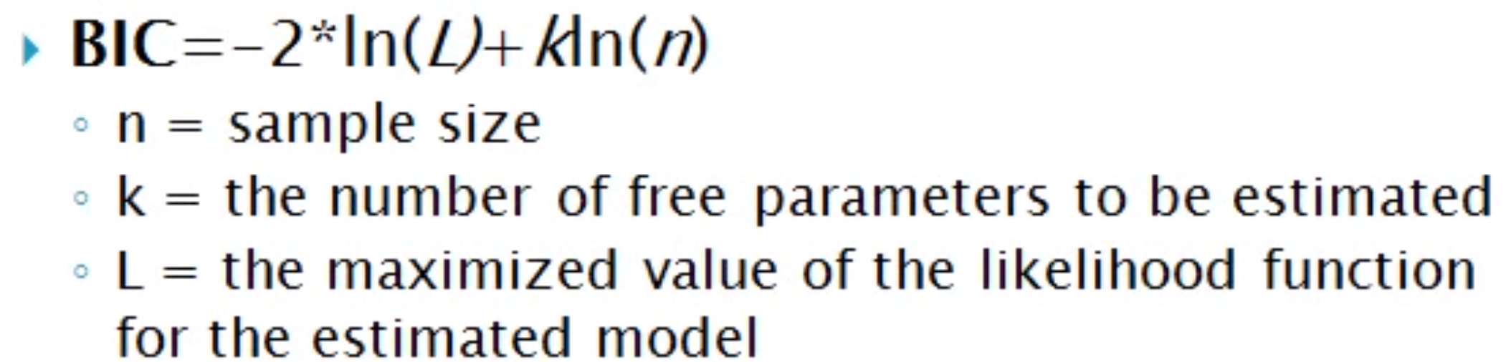
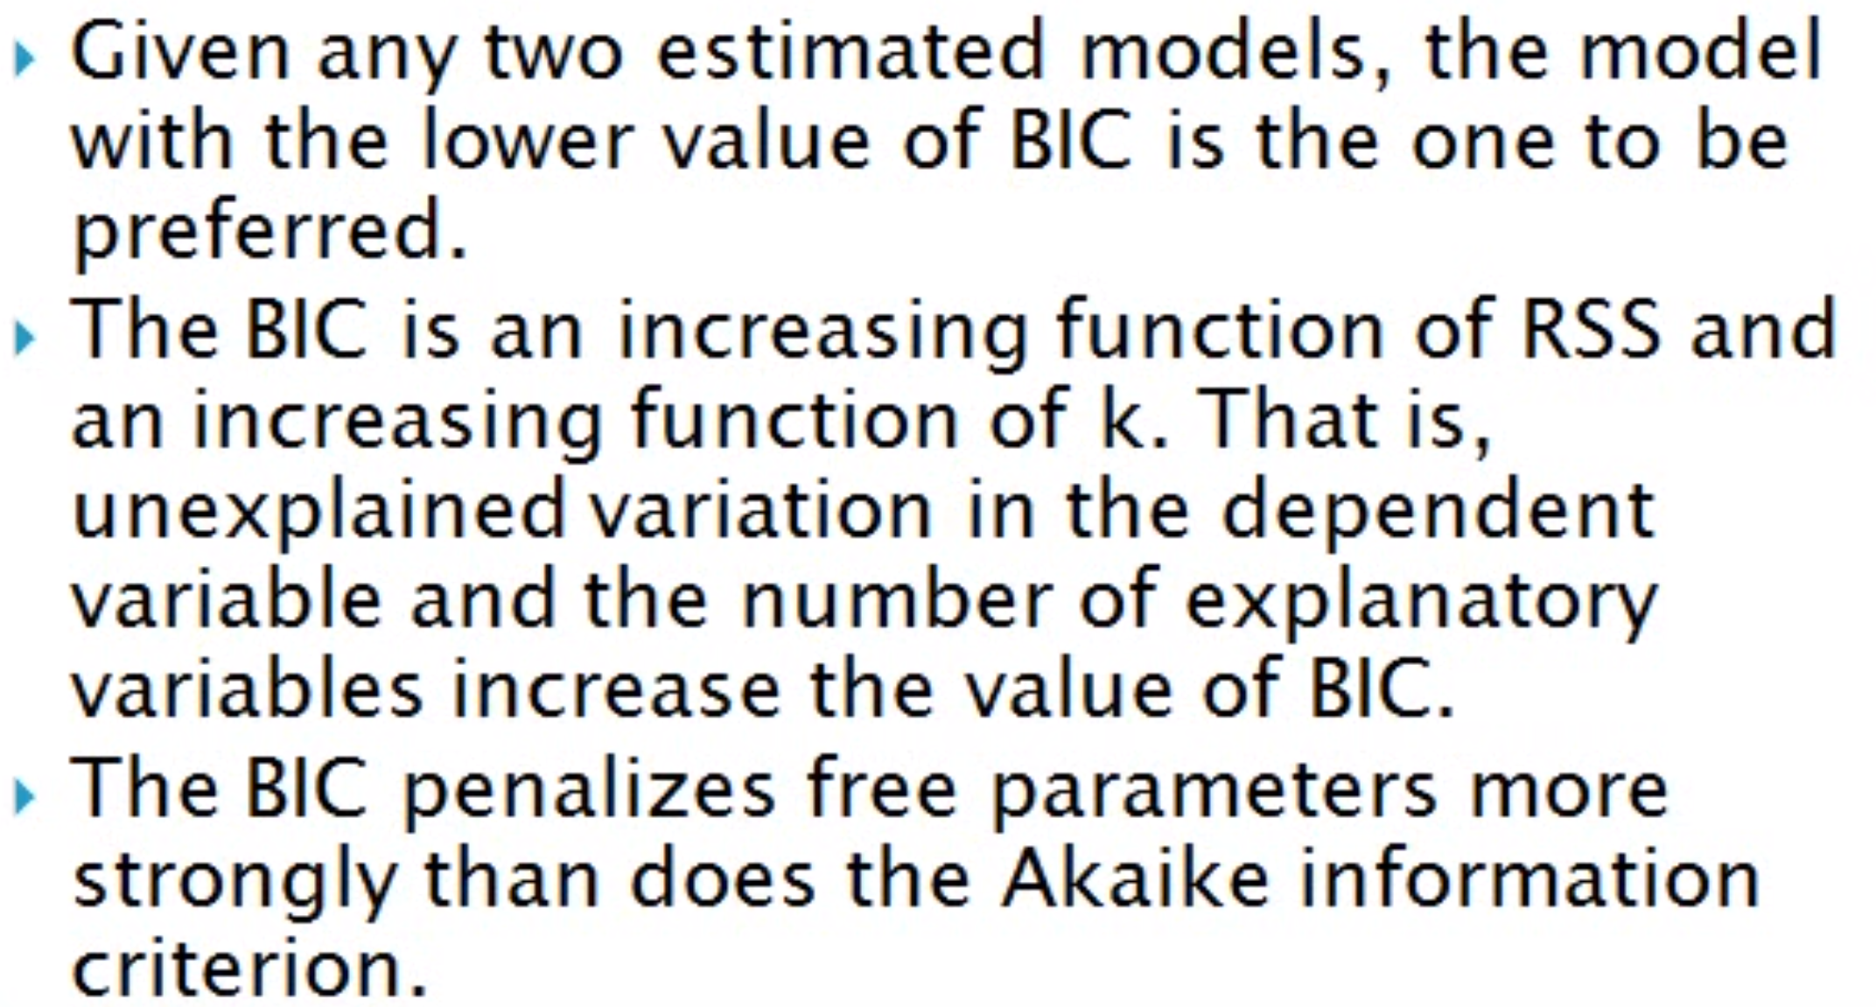
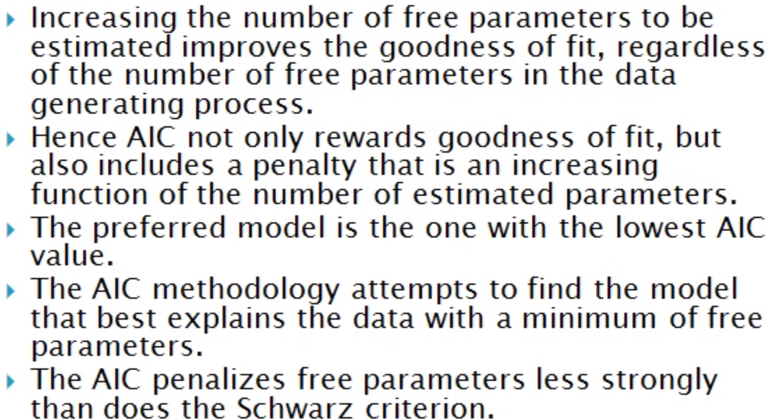
Model Scoring – AIC & BIC
Formula for AIC
Formula for BIC
Akaike’s Information Criterium
Bayesian Information Criterium

Slide 10
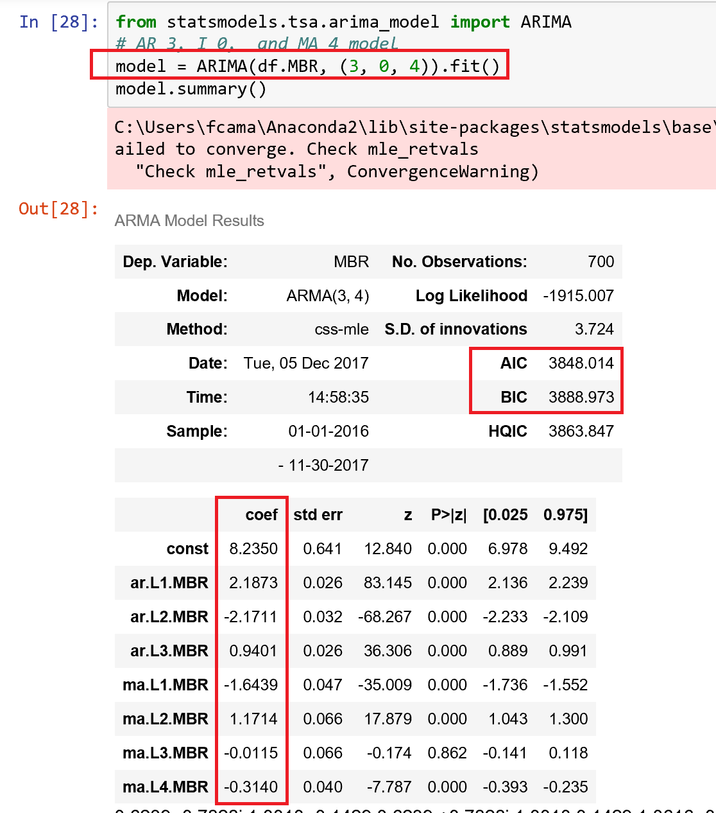
MBR Final Model ARMA

Slide 11
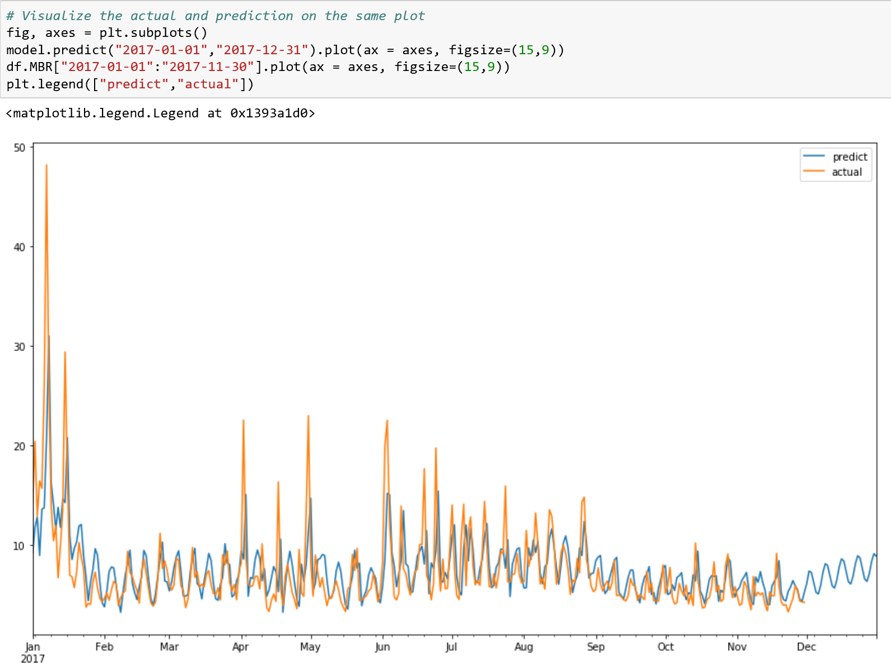
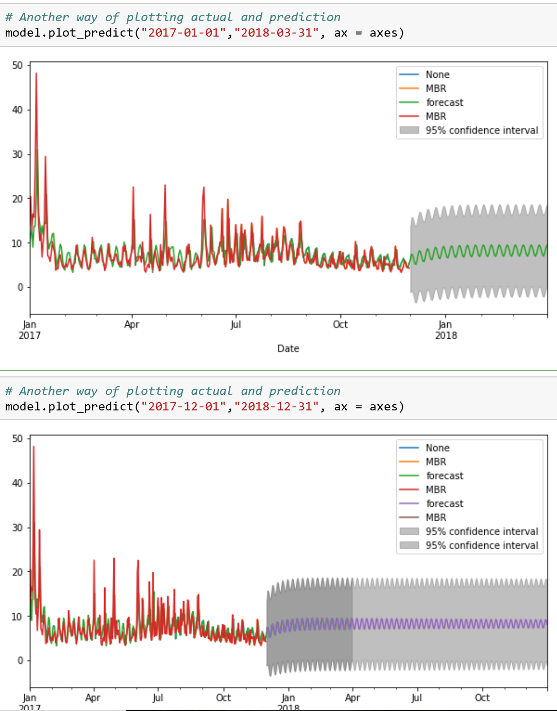
MBR - Final Model ARMA Graphs

Slide 12
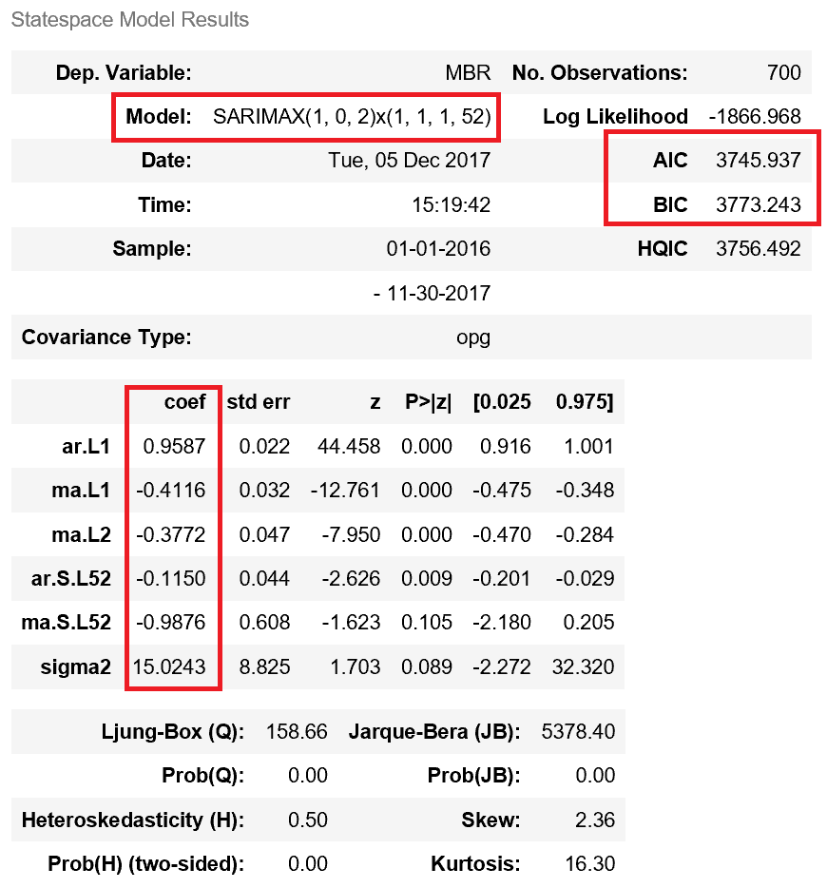
MBR Final Model SARIMA

Slide 13
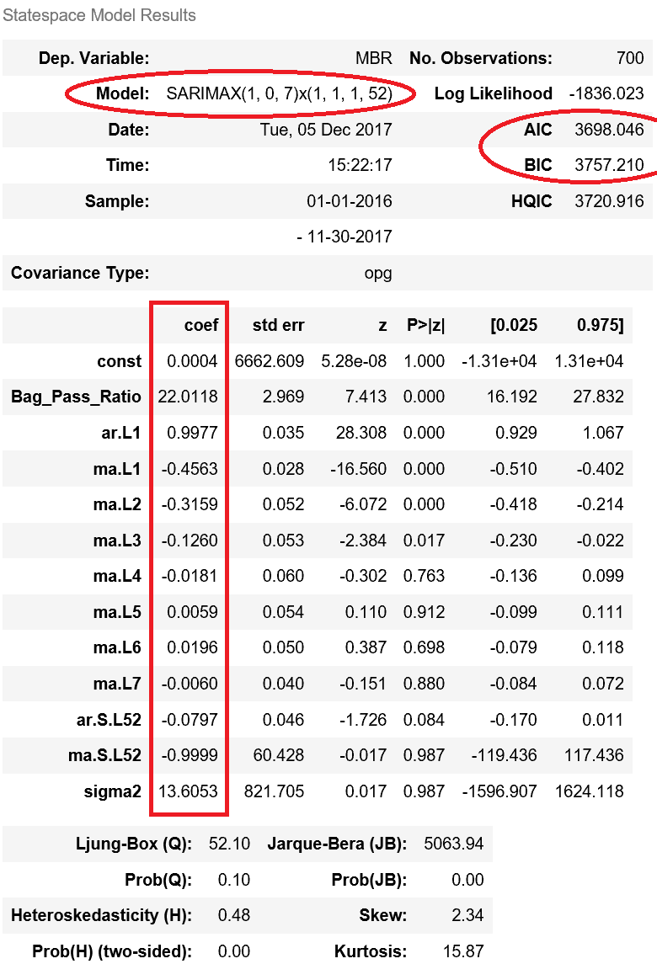
MBR Final Model SARIMAX

Slide 14


Slide 15
REFERENCES
1 - Retrieved from:
https://www.analyticsvidhya.com/blog/2016/02/time-series-forecasting-codes-python/
Times Series Intro
2 - Retrieved from:
https://www.youtube.com/watch?v=LXHj2xbVg1s
AIC and BIC formulas and descriptions

Slide 16
Project Requirements – Part 4
DELIVERABLES
iPython Report Draft
Requirements:
Create an iPython Notebook with code, visualizations, and markdown
Summarize your exploratory data analysis.
Explain your choice of validation and prediction metrics.
Frame source code so it enhances your notebook explanations.
Include a separate python module with helper functions
Consider it like an appendix piece; although unlike an appendix, it'll be necessary for your project to function!
Visualize relationships between your Y and your two strongest variables, as determined by some scoring measure (p values and coefficients, gini/entropy, etc).
Identify areas where new data could help improve the model
Bonus:
Many modeling approaches are all about fine-tuning the algorithm parameters and trying to find a specific value. Show how you optimized for this value, and the costs/benefits of doing so.

